Slide 1
CORPORATE CLASSIFIEDS
Your personal Online Exchange

Slide 2
OUR TEAM
HARI PRASAD K.R
(2135584)
VARUN G
(2136158)
RAJESH KUMAR GADELA
(2136314)
SHRUTHY SRI B
(2134850)

Slide 3





ARICHITECTURE DIAGRAM
Offer microservice
Classifieds Portal
Authentication microservice
Employee microservice
USER
(Medium)
Points microservice

Slide 4
REQUIREMENT ANALYSIS

Slide 5
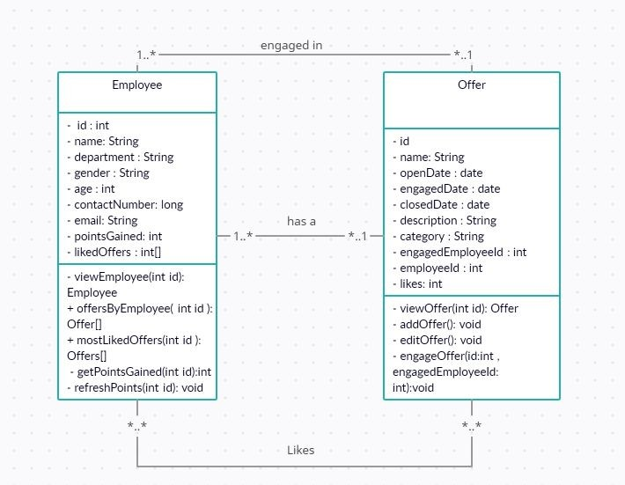
CLASS DIAGRAM

Slide 6
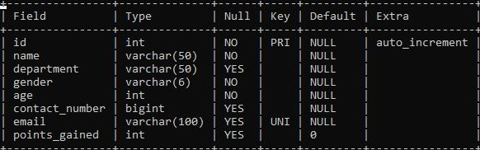
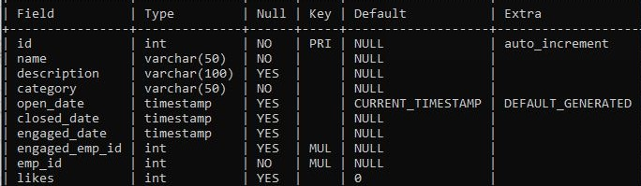
SQL TABLES
EMPLOYEE TABLE
OFFER TABLE

Slide 7
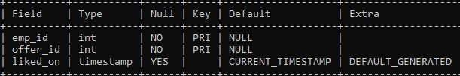
SQL TABLES(CONTINUED)
LIKED BY TABLE (To describe many to many relationship between offers and employee)

Slide 8
DEVELOPMENT & DESIGNING

Slide 9
MICROSERVICES
AUTH MICROSERVICE - to handle authentication of the employee.
EMPLOYEE MICROSERVICE - to handle employee related services.
OFFER MICROSERVICE - to handle offer related services.
POINT MICROSERVICE - to refresh points gained by the employee.

Slide 10
AUTH MICROSERVICES

Slide 11
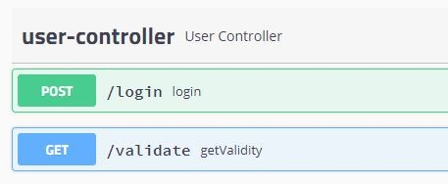
REST ENDPOINTS
/login - to log in the employee and generate jwt token
/validate - to validate the jwt token
A look at swagger.html for auth microservice

Slide 12

Rest Controller (a gist)
One of the Post mappings of the rest controller (to login the user)
Rest controller calls the UserServiceImpl.java where all the necessary details are implemented

Slide 13
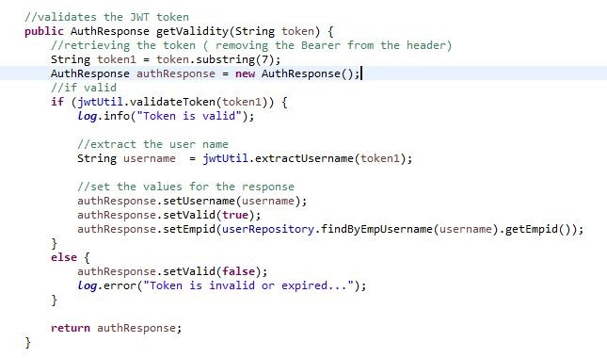
AUTH SERVICE

Slide 14
EXCEPTION HANDLING
Rest Exception handler - to handle all the exceptions that occurs in the microservice with proper status code.
Unauthorized Exception - thrown when the user is invalid.

Slide 15
EMPLOYEE MICROSERVICE

Slide 16
REST ENDPOINTS
/employee/viewProfile/{id} - to view employee details by id parameter.
/employee/viewEmployeeOffers/{id} - to view all the offers posted by the employee through id parameter.
/employee/viewMostLiked/{id} - to view top 3 most liked offers of the employee by id parameter.

Slide 17
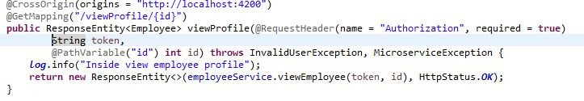
Rest Controller (a gist)
One of the Get mappings of the rest controller (to view the profile of the user)
Rest controller calls the employeeServiceImpl.java where all the necessary details are implemented

Slide 18
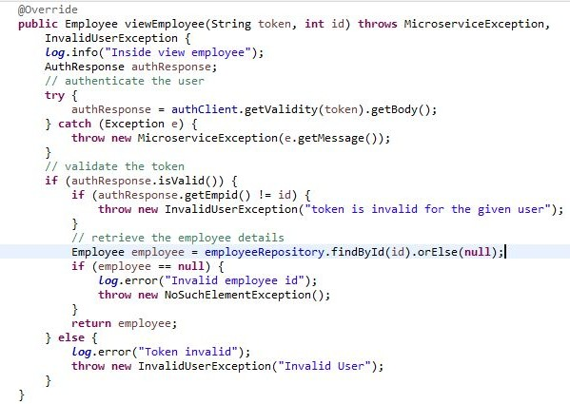
EMPLOYEE SERVICE

Slide 19
EXCEPTION HANDLING
Employee Exception handler - to handle all the exceptions that occurs in the microservice with proper status code.
InvalidUser Exception - thrown when the user is unauthorized.
Microservice Exception - thrown when there is an error in the communicated microservice.

Slide 20
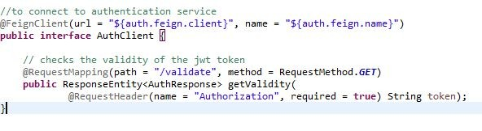
FEIGN CLIENTS
Auth client - to communicate with the authentication microservice.
Offer client - to communicate with the offer microservice.
Interface of AuthClient

Slide 21
OFFER MICROSERVICE

Slide 22
REST ENDPOINTS
/offer/addOffer - to post a new offer
/offer/editOffer - to edit an existing offer
/offer/engageOffer - to engage an offer
/offer/getOfferByCategory - to filter offers by category
/offer/getOfferByPostedDate - to filter offers by posted date
/offer/getOfferByTopLikes - to retrieve top 3 most liked offers
/offer/getOfferDetails/{id} - to retrieve offer by id parameter

Slide 23
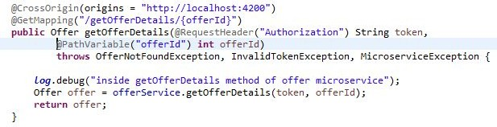
Rest Controller (a gist)
One of the Get mappings of the rest controller (to get the details of an offer by offer id)
Rest controller calls the offerService.java where all the necessary details are implemented

Slide 24
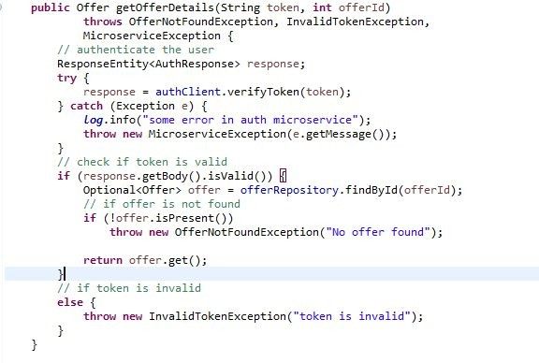
OFFER SERVICE

Slide 25
EXCEPTION HANDLING
Global Exception handler - to handle all the exceptions that occurs in the
microservice with proper status code.
EmployeeNotFoundException - thrown when no employee is found.
ImproperDateException - thrown when improper date is passed.
InvalidTokenException - thrown when the jwt token is invalid.
MicroserviceException - thrown when the communicated microservice is not working.
OfferNotFoundException - thrown when no offers are found.

Slide 26
FEIGN CLIENTS
Auth client - to communicate with the authentication microservice.
Employee client - to communicate with the employee microservice.
Interface of AuthClient

Slide 27
POINTS MICROSERVICE

Slide 28
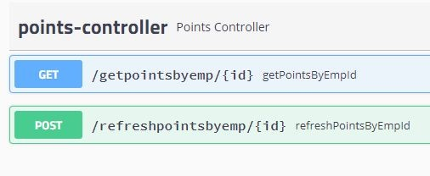
REST ENDPOINTS
/getpointsbyemp/{id}- to get points gained by the employee.
/refreshpointsbyemp/{id}- to refresh the points of the employee.
A look at swagger (for points)

Slide 29
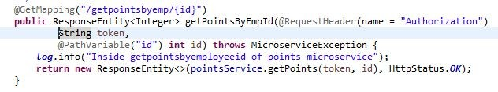
Rest Controller (a gist)
One of the Get mappings of the rest controller (to get the points gained by the employee)
Rest controller calls the pointsServiceImpl.java where all the necessary details are implemented

Slide 30
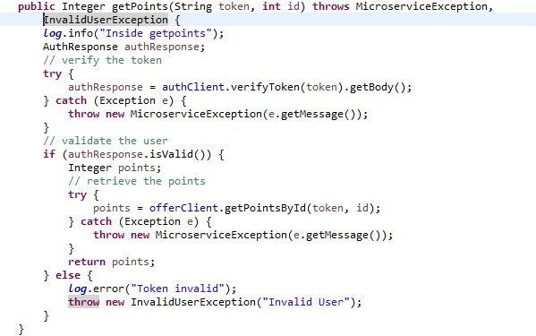
POINTS SERVICE

Slide 31
EXCEPTION HANDLING
InvalidUserException - thrown when the jwt token is invalid.
MicroserviceException - thrown when the communicated microservice is not working.
PointsExceptionHandler - to handle all the exceptions thrown by the rest controller.

Slide 32
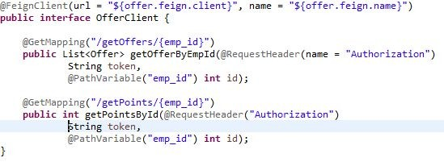
FEIGN CLIENTS
Auth client - to communicate with the authentication microservice.
Employee client - to communicate with the employee microservice.
Offer client - to communicate with the offer microservice.
Interface of Offer Client

Slide 33
TESTING

Slide 34
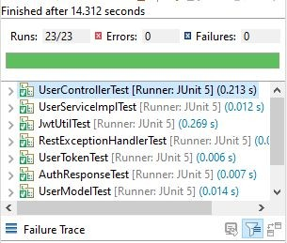
AUTH MICROSERVICE
AuthMicroserviceApplicationTests
UserControllerTest
RestExceptionHandlerTest
JwtUtilTest
ModelTests
UserServiceImplTest
There are 23 test cases and all of them pass successfully

Slide 35
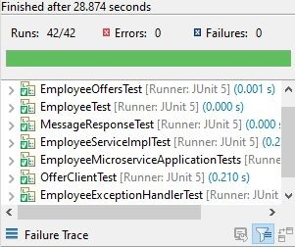
EMPLOYEE MICROSERVICE
EmployeeMicroserviceApplicationTests
OfferClientTest
EmployeeControllerTest
EmployeeExceptionHandlerTest
ModelTests
EmployeeServiceImplTest
There are 42 test cases and all of them pass successfully

Slide 36
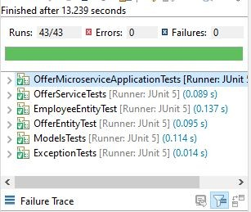
OFFER MICROSERVICE
EmployeeEntityTests
ExceptionTests
OfferEntityTests
OfferServiceTests
ModelTests
There are 43 test cases and all of them pass successfully

Slide 37
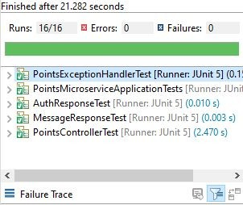
POINTS MICROSERVICE
PointsMicroserviceApplicationTest
PointsControllerTests
PointsExceptionHandlerTests
ModelTests
There are 16 test cases and all of them pass successfully

Slide 38
USER INTERFACE

Slide 39
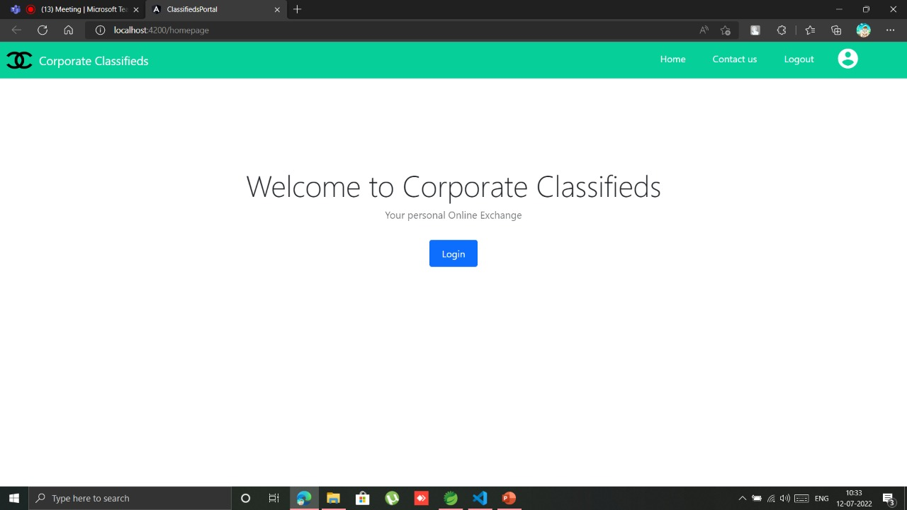
LANDING PAGE

Slide 40
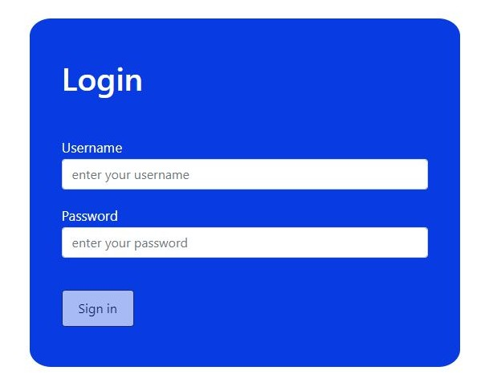
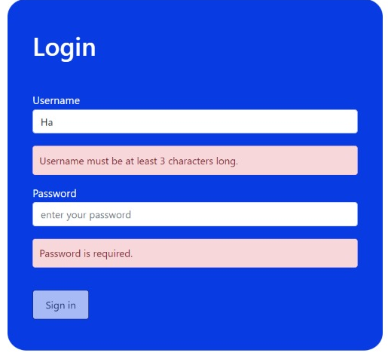
LOGIN PAGE
Proper validation for each field

Slide 41
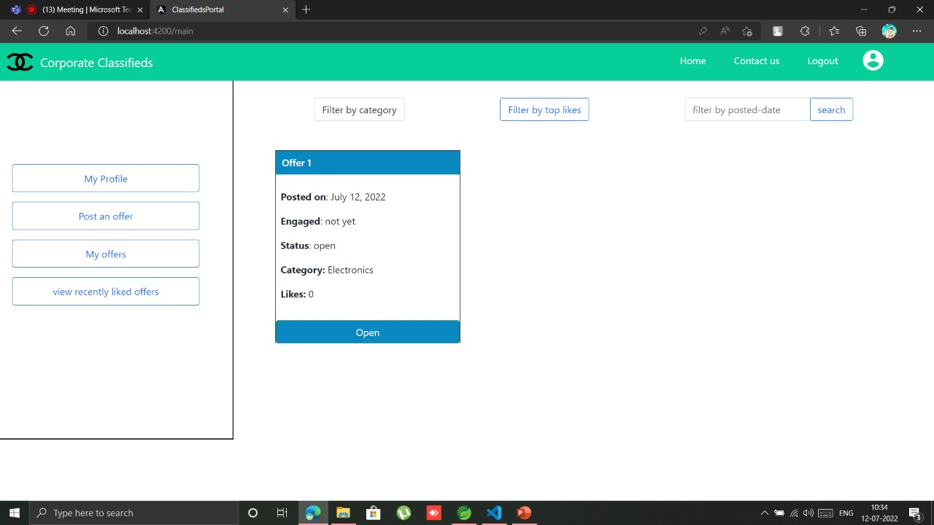
MAIN PAGE
Options to filter data by category, top likes or by posted date

Slide 42
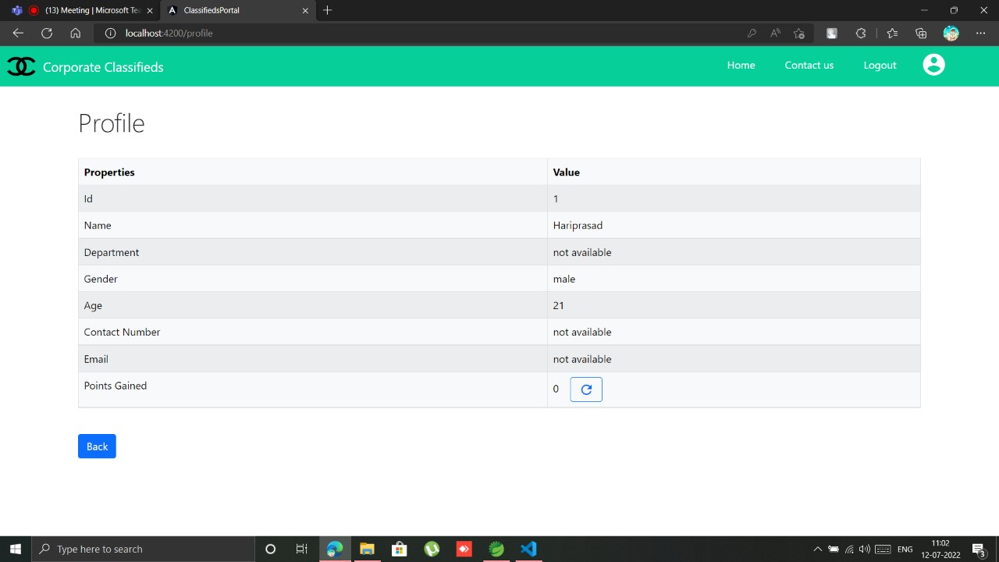
PROFILE PAGE

Slide 43
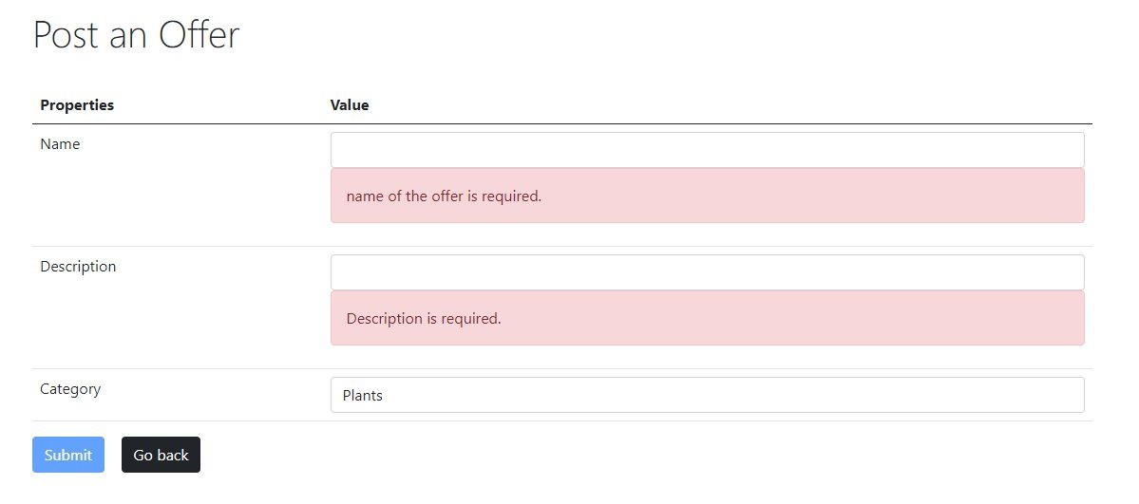
POST OFFER PAGE

Slide 44
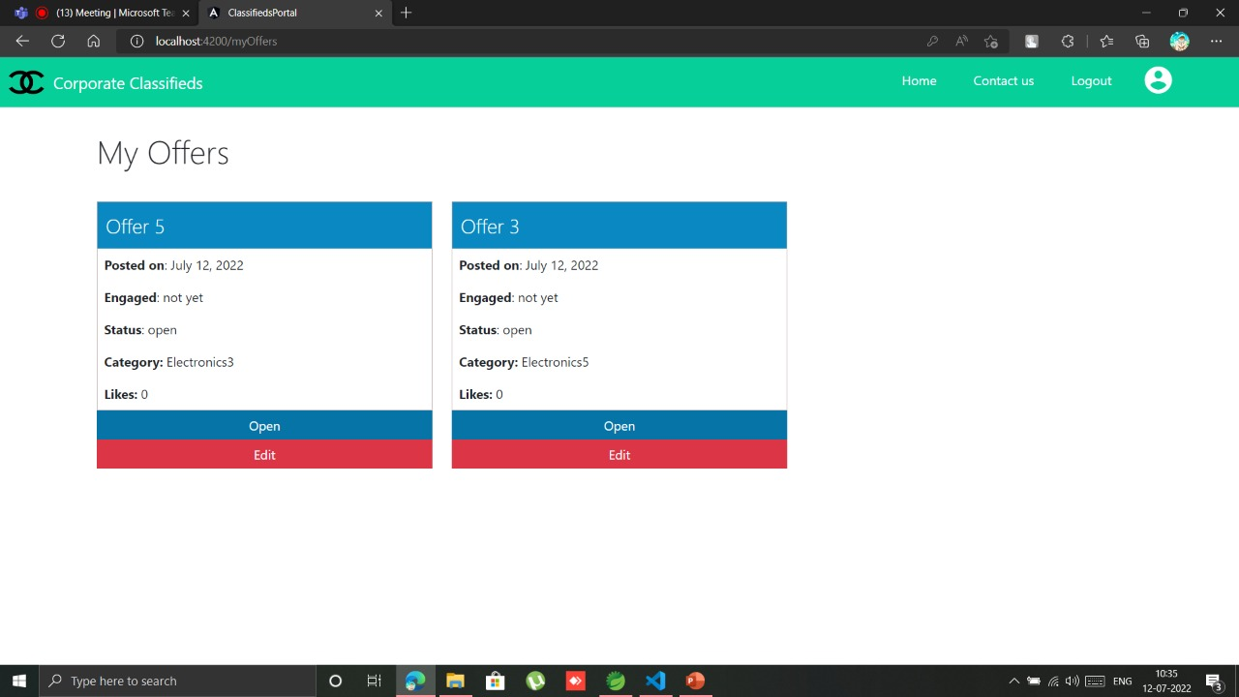
MY OFFERS PAGE

Slide 45
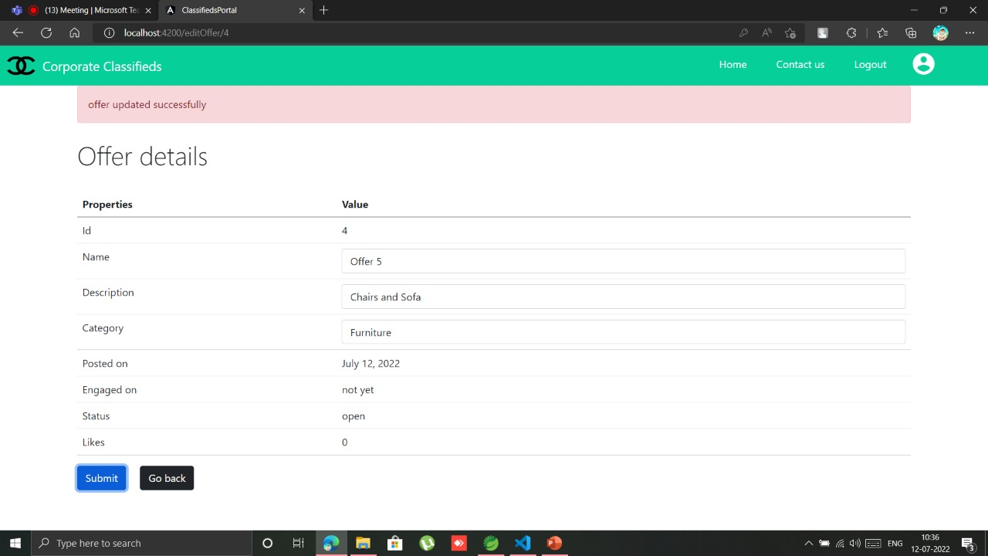
EDIT OFFER PAGE

Slide 46
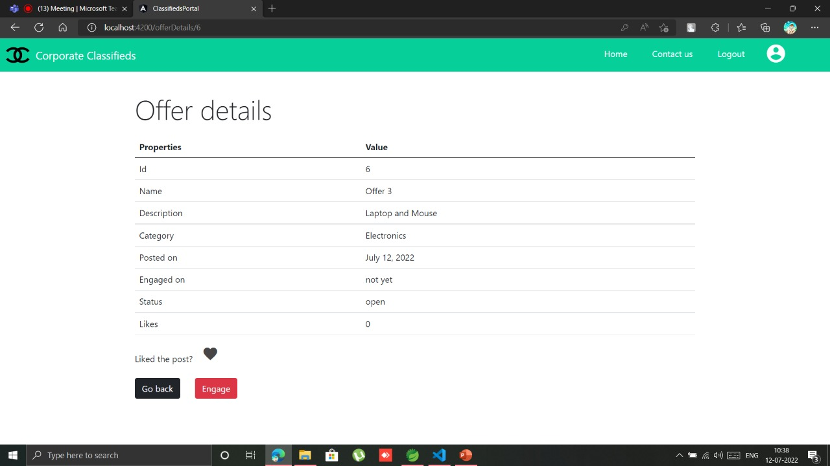
OFFER DETAILS PAGE

Slide 47
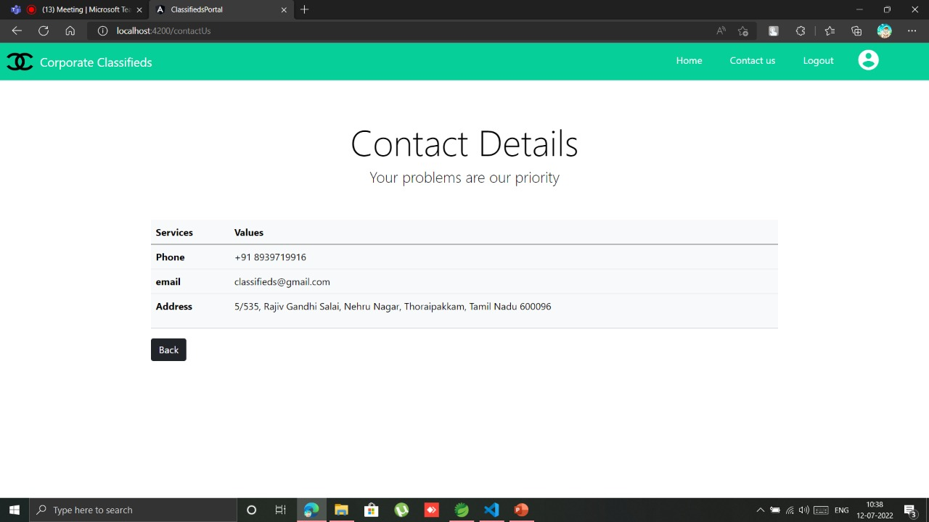
CONTACT US PAGE

Slide 48
DEPLOYMENT

Slide 49
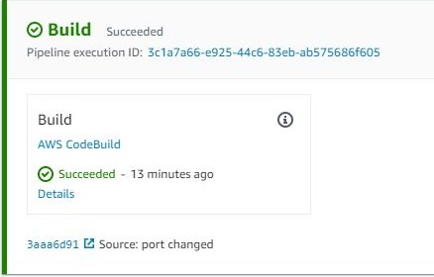
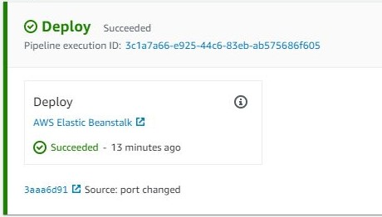
AUTH MICROSERVICE
Build Stage
Deploy Stage

Slide 50
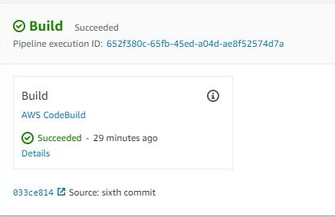
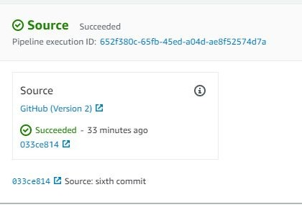
EMPLOYEE MICROSERVICE
Build Stage
Source Stage

Slide 51
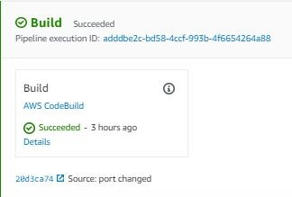
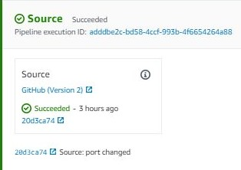
OFFER MICROSERVICE
Build Stage
Source Stage

Slide 52
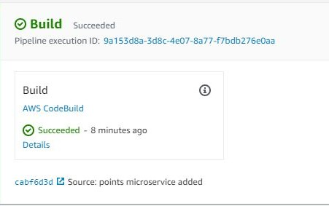
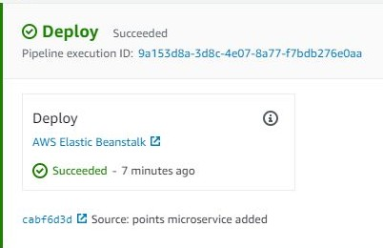
POINTS MICROSERVICE
Build Stage
Deploy Stage

Slide 53
THANK YOU

